Slide 1

demoversion@prsntr.com
3 STEPS TO A
Perfect Presentation
Use our simple 3-step planner to ensure your presentation is perfect in every way
Start Here !

Slide 2

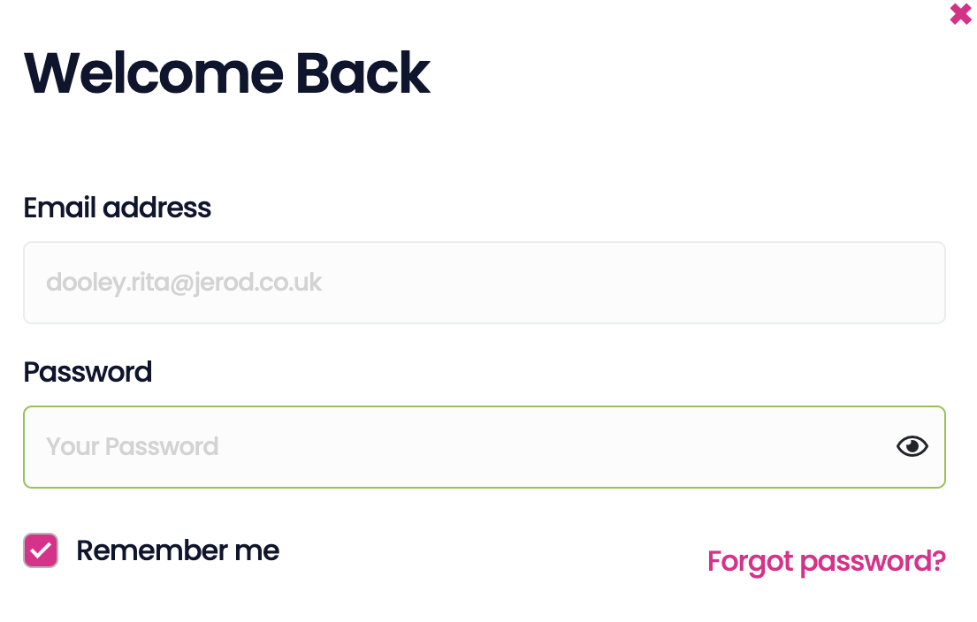


1
2
BUILD
Welcome to
PRSNTR
Well-structured presentation
PRESENTATION IN YOUR POCKET
&
We’re here to help you make presenting easier
Receive feedback & get world
class tips
Log In
Create your account
OR
Sign in
Microsoft Login

Slide 3
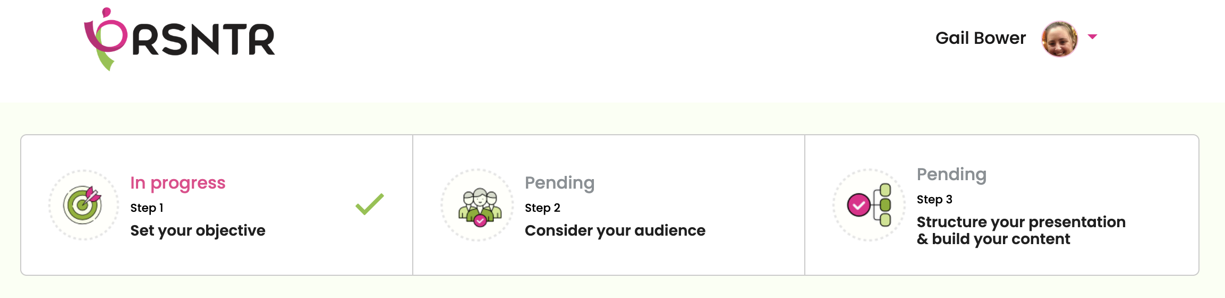


demoversion@prsntr.com
3 EASY STEPS
STEP 1
STEP 2
STEP 3
Set Your
Objective
Consider Your Audience
Structure Your Presentation & Build Your Content
Pending
Pending
Pending

Slide 4
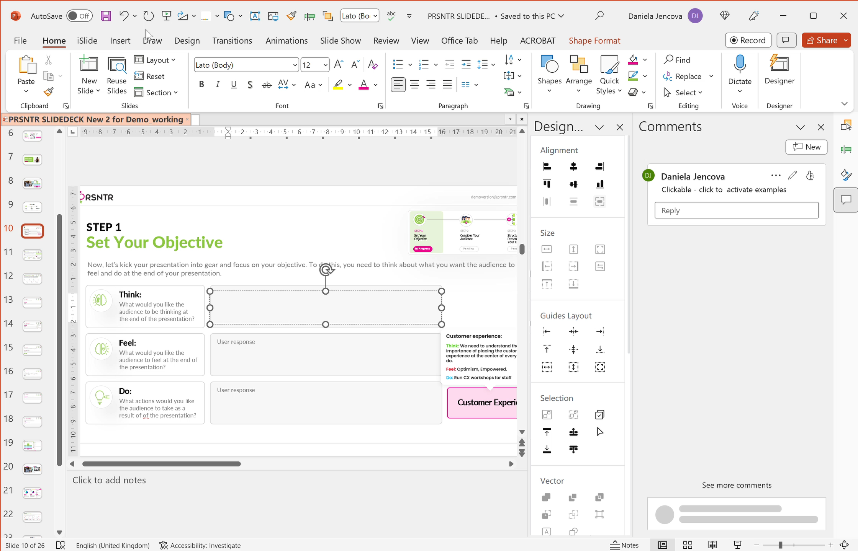

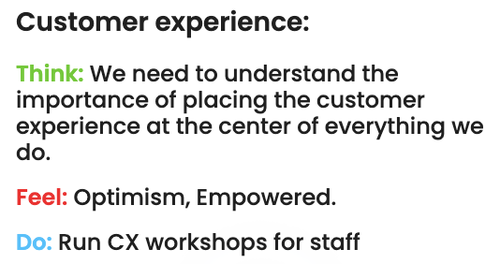



demoversion@prsntr.com
STEP 1
Set Your Objective
STEP 1
STEP 2
STEP 3
Set Your
Objective
Consider Your Audience
Structure Your Presentation & Build Your Content
In Progress
Pending
Pending
Now, let’s kick your presentation into gear and focus on your objective. To do this, you need to think about what you want the audience to think, feel and do at the end of your presentation.
Think:
User response
What would you like the audience to be thinking at the end of the presentation?
Feel:
User response
What would you like the audience to feel at the end of the presentation?
Do:
User response
What actions would you like the audience to take as a result of the presentation?
Click here to see
the examples
Customer Experience
NEXT

Slide 5


One of the secretes to a good presentation is engaging your audience. It’s important to understand who the decision makers and key influencers are in your audience. If you understand their comunication style you can tailor your message to ensure relevancy and success
demoversion@prsntr.com
STEP 2
Audience Analysis
STEP 1
STEP 2
STEP 3
Set Your
Objective
Consider Your Audience
Structure Your Presentation & Build Your Content
Completed
In Progress
Pending
One of the secretes to a good presentation is engaging your audience. It’s important to understand who the decision makers and key influencers are in your audience. If you understand their comunication style you can tailor your message to ensure relevancy and success
To understand the different comunication styles click on the green button on the right
How to tailor to the 4 comunication styles
1.Name*
*identify the key people in your audience
User response
2. Selected communication style below are characteristic of people communication styles, select the appropriate style for your people in your audience
Animated
Dominant
Friendly
Analytical
Big picture thinking
Outcome focused
Calm
High attention to detail
High energy
Concise and to the point
Personable
Logical & process orientated
Loud
Decisive
Favours small talk
Requires evidence
BACK
NEXT

Slide 6
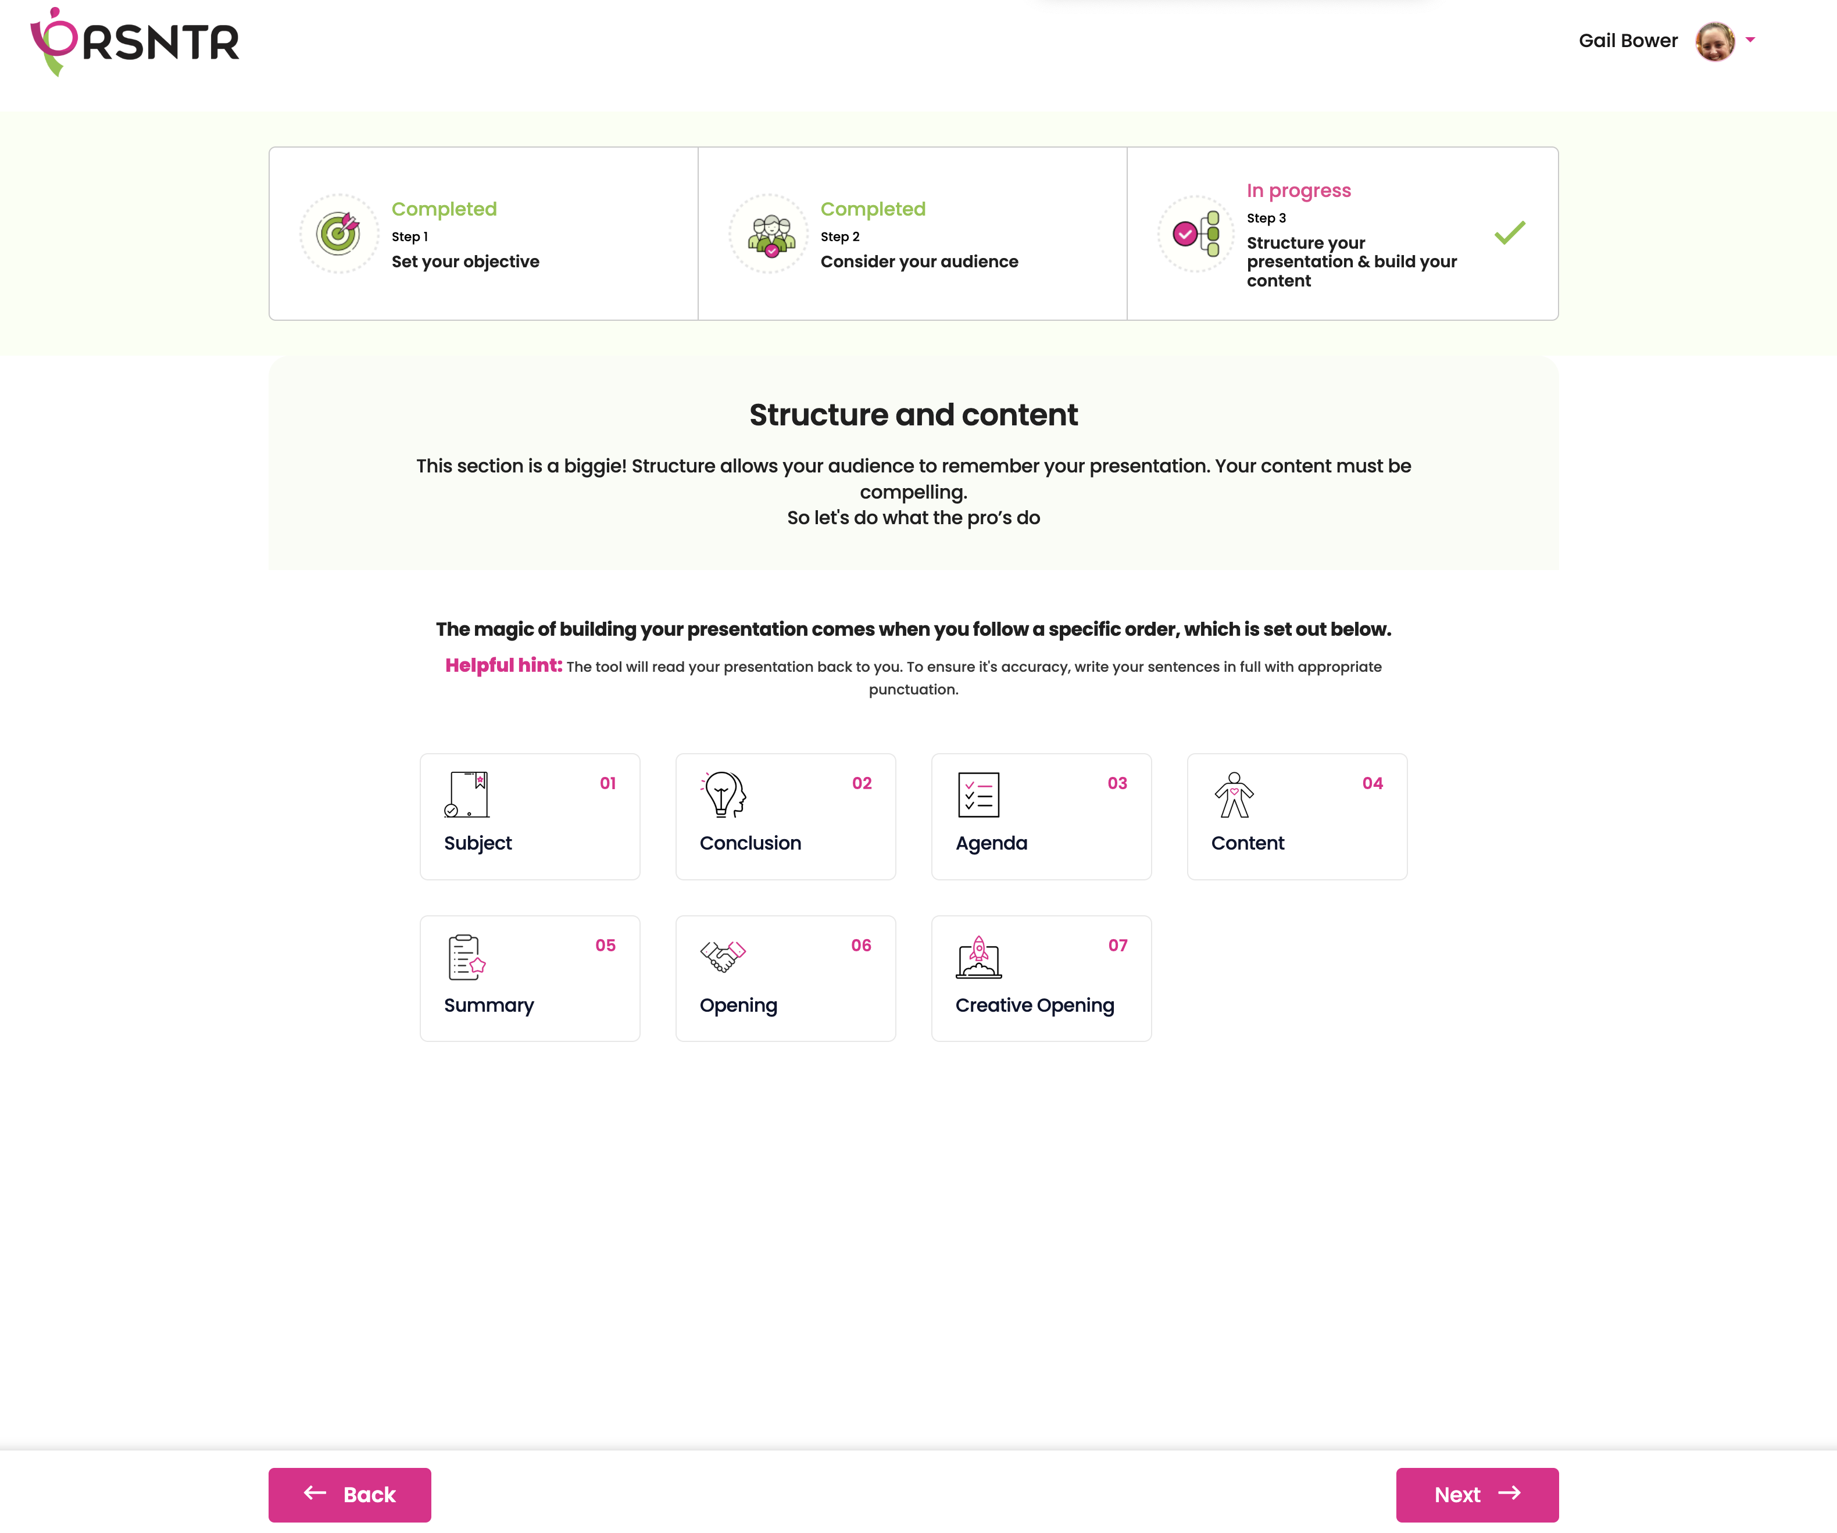
demoversion@prsntr.com
STEP 3
Develop and Structure Your Content
STEP 1
STEP 2
STEP 3
Set Your
Objective
Consider Your Audience
Structure Your Presentation & Build Your Content
Completed
Completed
In Progress
This section is a biggie! Structure allows your audience to remember your presentation. Your content must be compelling.
So, let’s do what the pros do !
The magic of building your presentation comes when you follow a specific order, which is set out bellow
Helpful hint: The tool will read your presentation back to you. To ensure it’s accuracy, write your sentences in full with appropriate punctuation
BACK
NEXT

Slide 7
demoversion@prsntr.com
SUBJECT
STEP 1
STEP 2
STEP 3
Set Your
Objective
Consider Your Audience
Structure Your Presentation & Build Your Content
Completed
Completed
In Progress
Identify how you will introduce the subject of your presentation
Tips:
Write your topic in ‘active verb’.
Write with conversational language to bring it to life
Click here for examples
User response
BACK
NEXT

Slide 8


demoversion@prsntr.com
CONCLUSION
STEP 1
STEP 2
STEP 3
Set Your
Objective
Consider Your Audience
Structure Your Presentation & Build Your Content
Completed
Completed
In Progress
A conclusion is an action or a next step you would like the audience to take. Write down your overall thoughts and ensure your “do” in your objective is reflected in your conclusion
Click here for examples
Think:
I’m competent
Feel:
User response
Reassured
Do:
Take PRSNTR
BACK
NEXT

Slide 9
demoversion@prsntr.com
AGENDA’S
STEP 1
STEP 2
STEP 3
Set Your
Objective
Consider Your Audience
Structure Your Presentation & Build Your Content
Completed
Completed
In Progress
To keep it simple and easy to follow, break your presentation into 3 key agendas. Try and stick to these 3 agendas. This will assist retention and clarity of your message. If 3 is not possible, the maximum number of agendas in your presentation should be 5.
Note: The agendas on this page are only headings and will be expanded on in the next section. Restrict your headings to one sentence.
Click here for examples
Write down your agendas in the space below
User response
User response
+ Add Agenda
BACK
NEXT

Slide 10



demoversion@prsntr.com
CONTENT
STEP 1
STEP 2
STEP 3
Set Your
Objective
Consider Your Audience
Structure Your Presentation & Build Your Content
Completed
Completed
In Progress
It’s now the time to build your content.
Ensure that the message will connect with the audience by including following:
01
02
03
Persuasive
Information
Tell Stories
When presenting research, be sure to emphasise the key takeout for your audience at the beginning or end of sharing the data.
Research
*click to learn more
*click to learn more
*click to learn more
Agenda 1
Build your content for agenda
Why it's important
User response
BACK
NEXT

Slide 11
demoversion@prsntr.com
SUMMARY
STEP 1
STEP 2
STEP 3
Set Your
Objective
Consider Your Audience
Structure Your Presentation & Build Your Content
Completed
Completed
In Progress
Think about the key messages you would like your audience to walk away with.
These are your summary points
Click here for examples
User response
BACK
NEXT

Slide 12
demoversion@prsntr.com
CREATIVE OPENING
STEP 1
STEP 2
STEP 3
Set Your
Objective
Consider Your Audience
Structure Your Presentation & Build Your Content
Completed
Completed
In Progress
You may decide to use a creative opening to grab attention of your audience!
This can focus their attention more excitedly on the subject. A creative opening can be
Question
Example
Short Story
Visual Aid
But remember, it must still relate to your subject.
Click here for examples
User response
BACK
NEXT

Slide 13
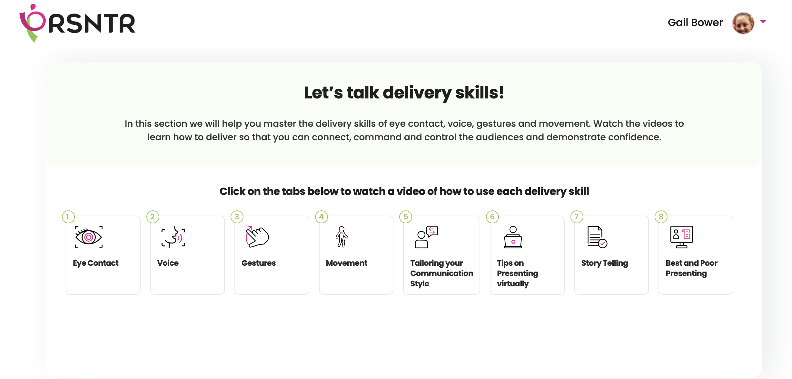
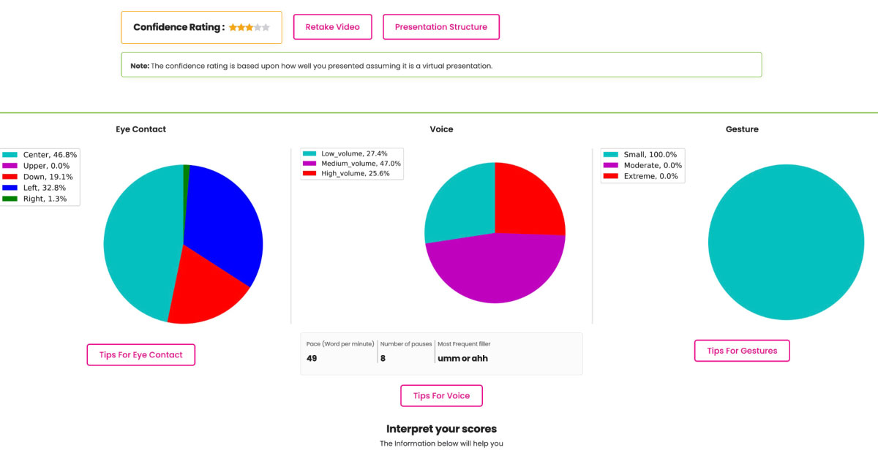
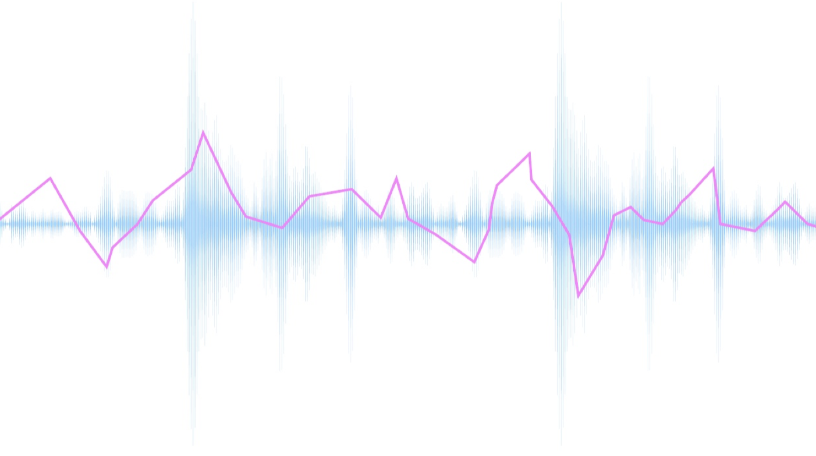
demoversion@prsntr.com
AI DRIVEN FEEDBACK DASHBOARD
Confidence Rating:
Retake Video
Presentation Structure
Coaching Videos
EYE CONTACT
VOICE
GESTURE
(Your feedback is based on the number of gestures not the quality )
Minute 1:
Awesome, that was magnificent! You are using your gestures to add interest.
Minute 2:
We didn’t see any gestures. Is this a missed opportunity?
Consider using gestures to help you emphasise your key message
Pace (wpm) Pauses Filler word
186 4 Um/like
Tips for Eye Contact
Tips for Voice
Tips for Gesture
EYE CONTACT SCORE:
Face to face:
You are aiming for an even spread of eye contact, left, center and right and very little looking down or up. If you have key people in your audience, you should be giving them more than 50% of the eye contact but not at once
Virtual:
Your eye contact should be at least 90% in the center, as your camera is your audience.
VOICE SCORE:
Pace: A comfortable presenting pace should be between 100 and 150wpm
Tip: If your pace is too fast, pause more
Pause:
You should aim for 6-8 pauses per minute
Tip: A pause can in a sentence or at the end. You pause for punctuation and emphasis
Filler words:
Try and eliminate your filler words
Tip: Replace your filler word with a pause
GESTURES:
Calculate your total score. Exceptional presenters, gesture on average 20 - 30 times in 2 minutes.
Presenting in meeting rooms: You need more conservative to moderate gestures
Virtual Presentations: You need more moderate gestures
Presenting in an auditorium: You need a greater number of dynamic gestures

Slide 14
COACHING TIPS
Let’s Talk Delivery Skills
In this section we will help you master the delivery skills of eye contact, voice, gestures and movement. Watch the videos to learn how to deliver so that you can connect, command and control the audience and demonstrate confidence.
Click on the tabs below to watch a video of how to use each delivery skill
01
02
03
04
Eye
Contact
Voice
Gesture
Movement
05
06
07
08
Tailoring Your Communication Style
Tips on Presenting Virtually
Story
Telling
Best and Poor Presenting

